Slide 1
INTRODUCTION TO MARKETING
0
Chapter 3
The Cultural
Environment
NGUYEN THI PHUONG*
THANG LONG UNIVERSITY
*MA in Global Marketing, PHD in Economics

Slide 2
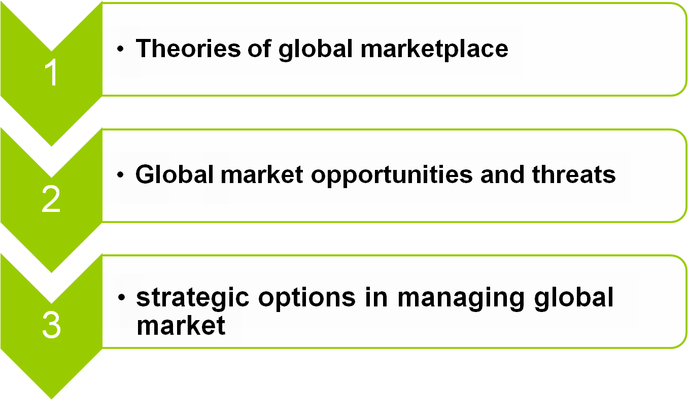
SESSION 12: Global marketplace
Copyright © 2011 Pearson Education
15-<number>

Slide 3
13.1 Theories of global marketplace
A market is an institutional structure that permits people and organizations to exchange goods, services and labor
For example: The United States, Canada, and Mexico form a quasi-free market governed by the North American Free Trade Agreement. The European Union is also a market.
A global market is not limited to specific geographic locations but rather involves the exchange of good, services, and labor anywhere in the world
Copyright © 2011 Pearson Education
15-<number>

Slide 4
Standardization: The goods and services traded in the global marketplace should be standardized
For example, appliances should operate on the standard electrical system or regulations of environmental and safety standards
Trust: Global market participants must have confidence that everyone will follow the same rules of the marketplace, and the rules will be uniformly enforced
For example: all parties will be enforced by the legal system
Copyright © 2011 Pearson Education
15-<number>

Slide 5
13.2 Global market opportunities and threats
Globalization is a source of opportunities as well as a source of threats.
Opportunities
Economies of scale: create mass-demand, a global company can serve several segments in different countries
Exploitation of lower input costs: differential resource/prices might be better exploited in an international supply-chain (unskilled labor in Asia and skilled labor in Europe)
Copyright © 2011 Pearson Education
15-<number>

Slide 6
Risk compensation: a portfolio of world-wide activities is less risky than once concentrated in a single or a few local markets
Optimality of market segmentation: Being present in several countries also allows the firms to exploit market segmentation and increase marginal revenues
Copyright © 2011 Pearson Education
15-<number>

Slide 7
Threats:
High competition from international competitors
Industry/culture field: There are as many cultures as there are countries
Demographic (population, income, size of geographic area, stage of life cycle) in local country
Readiness is crucial: Structure, manpower, and resources must all be in order before proceeding
Copyright © 2011 Pearson Education
15-<number>

Slide 8
Legalities of trading in a new country
Wealth of the country and the level of development: Cuba has a cheap labor, production costs but because of the lengthy embargo, the infrastructure is yet underdeveloped with slow internet capability=> difficult to expand to this market
Copyright © 2011 Pearson Education
15-<number>

Slide 9
13.3 Strategic options in managing global market
Intense growth can take place when current products and current markets have the potential for increasing sales
Market penetration
Market development
Product development
Diversified growth: new products are developed to be sold in new markets
Copyright © 2011 Pearson Education
15-<number>

Slide 10
Integrated growth
Forward integration: when a company takes ownership or increased control of its distribution system.
Backward integration occurs when a company takes ownership or increased control of its supply systems
Horizontal integration occurs when a company takes ownership or control of some of its competitors.
Copyright © 2011 Pearson Education
15-<number>

Slide 11
Homework
1. Discuss how slower population growth will affect business in your local community
2. Some demographic characteristics are more important than others in determining market potential. For each of the following characteristics, identify two products for which this characteristic is most important: (a) population, (b) income, (c) size of geographic area, (d) stage of life cycle when your company operates internationally
Copyright © 2011 Pearson Education
15-<number>

